Slide 1

Queen Bees Bienenkonigin
Mikhaela Mueller, Meredith Hogue, Narbada Acharya, Jack Hickey, Minu Perera

Slide 2
Agenda
Restate Problems
Original Requirements
Screen mockups – “Guided Tour”
Conclusion/Questions

Slide 3
Overview of Problems
Website is not very user-friendly​​
Lackluster -- no Images/Videos​​
Lacks clear Mission Statement​​
Missing a “call to action” – an encouragement to donors​​
Very difficult to find

Slide 4
Requirements for improved Cardinal Cupboard
Separate login for employees with access to Canva, financials, etc.
Implement a payment system where donations can be made online
Highlight Cardinal Cupboard’s impact/sustainability efforts
Highlight Volunteers and CC Team
Provide access/info. to campus resources
Recipes page
Blog/Newsletter page
Links to social media
Create more streamlined forms (food intake, general survey, experience. Etc.)
Make sure data is collected in central location

Slide 5
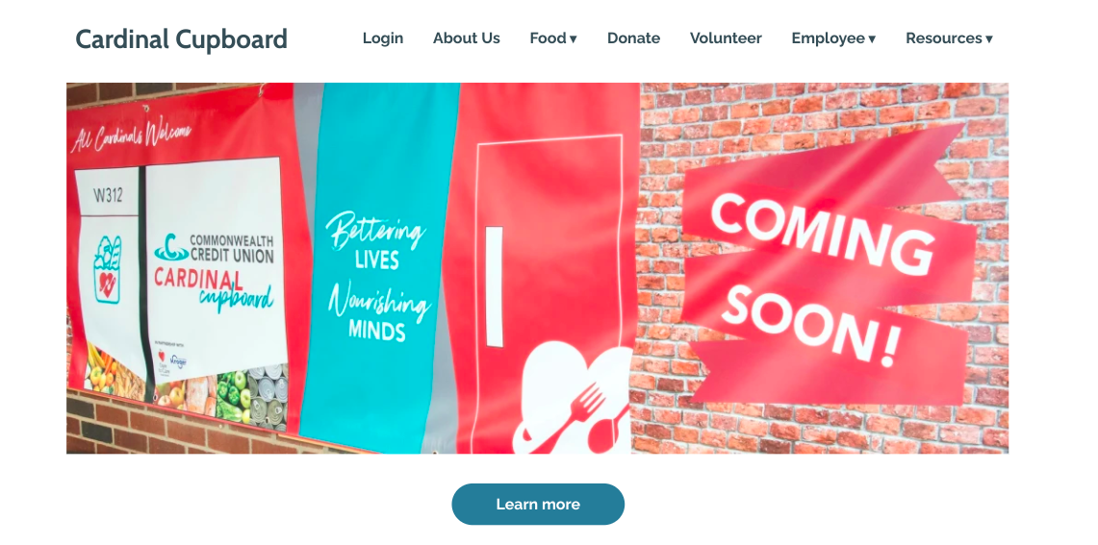
Homepage

Slide 6
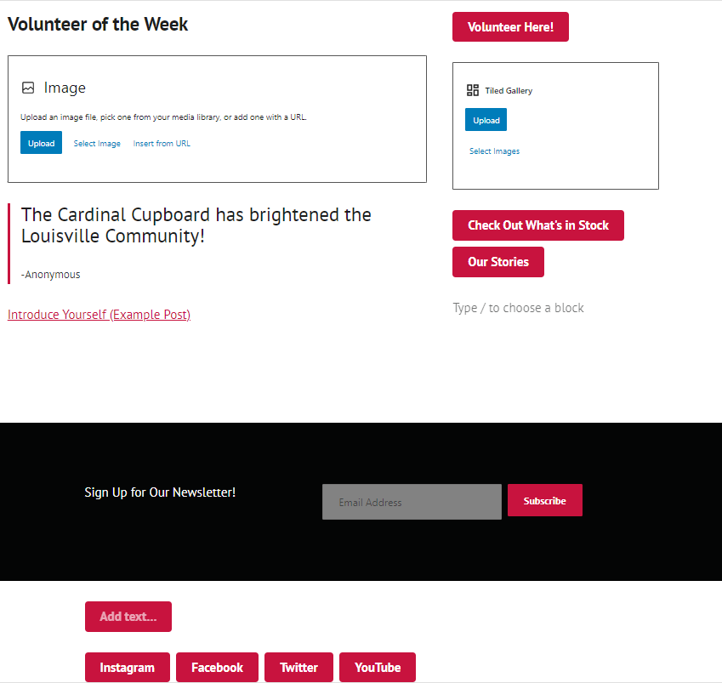
Homepage Cont.

Slide 7

Homepage – Access Social Media

Slide 8
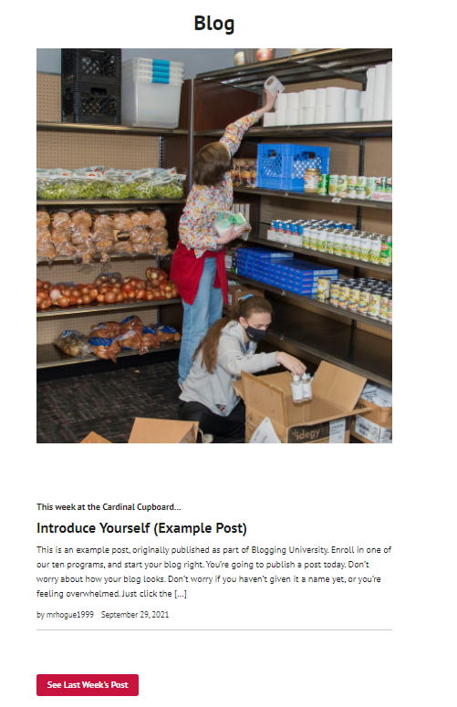

Homepage - Blog

Slide 9
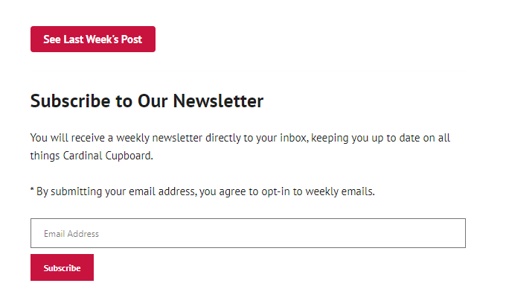
Homepage - Newsletter

Slide 10
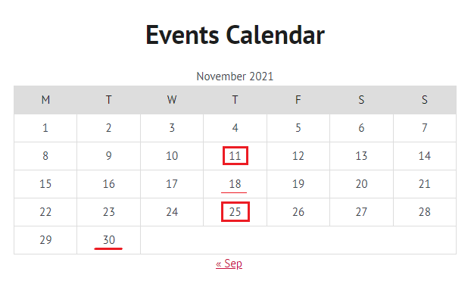
Homepage – Events Calendar

Slide 11
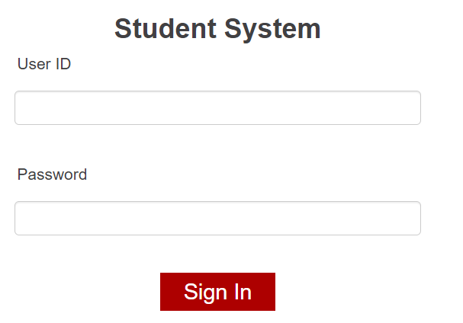
Guest Login

Slide 12
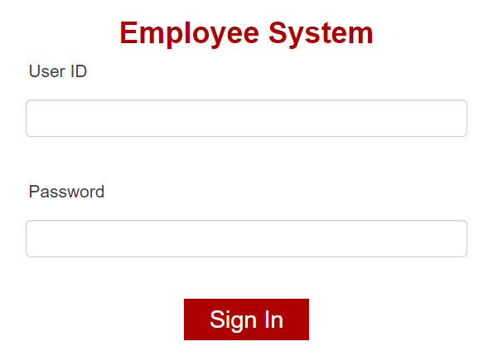
Employee Login

Slide 13
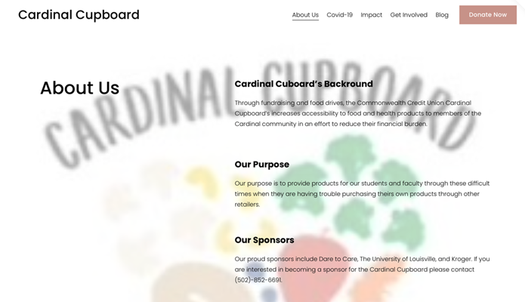
About Us/ Sponsors

Slide 14
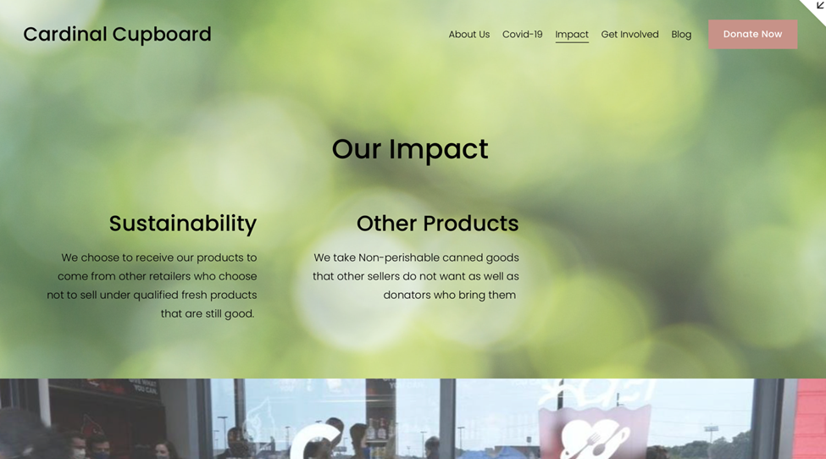
About Us Cont. – Impact/Sustainability

Slide 15
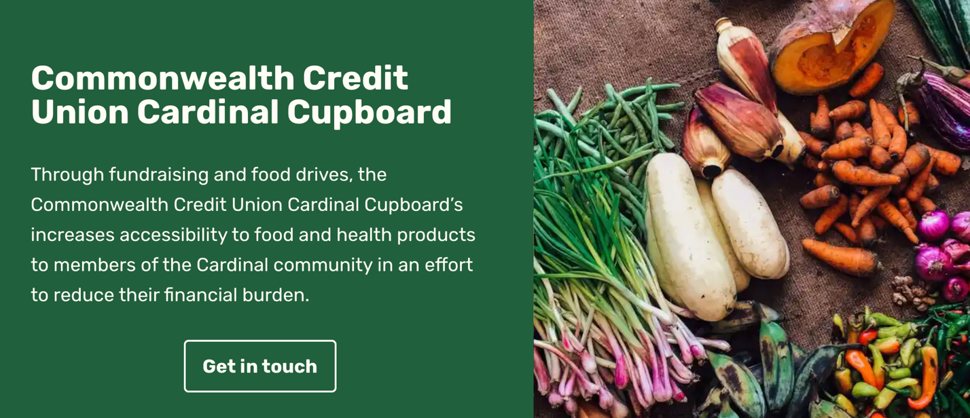
About Us Cont. – Mission Statement

Slide 16
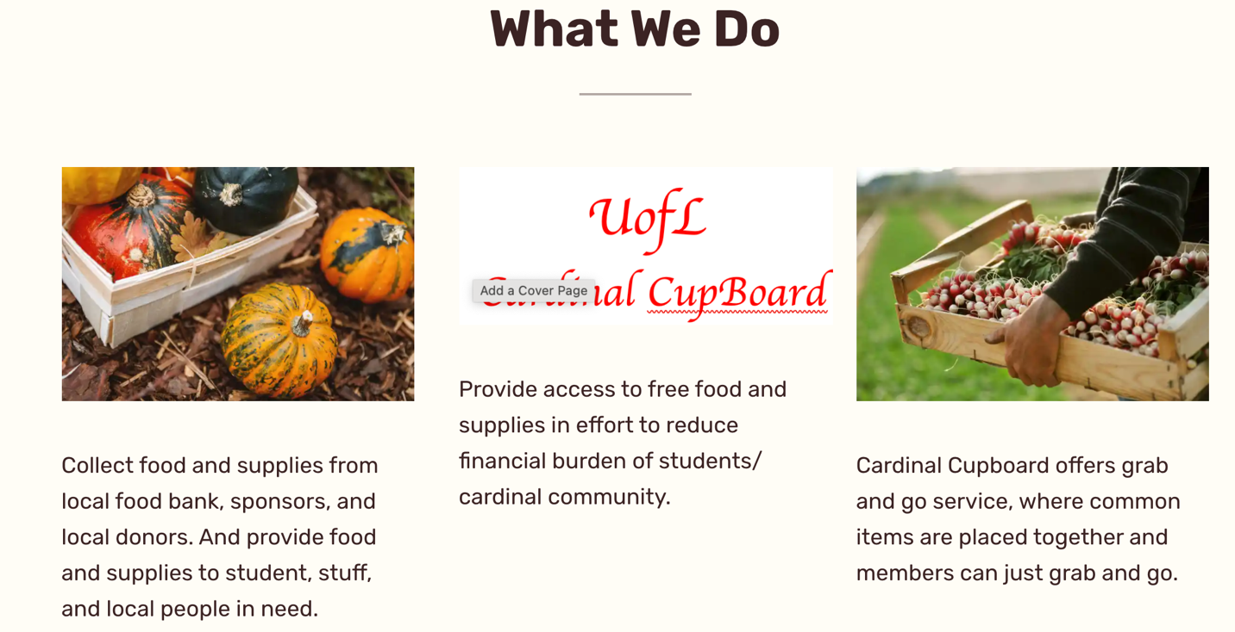
About Us Cont. – What We Do

Slide 17
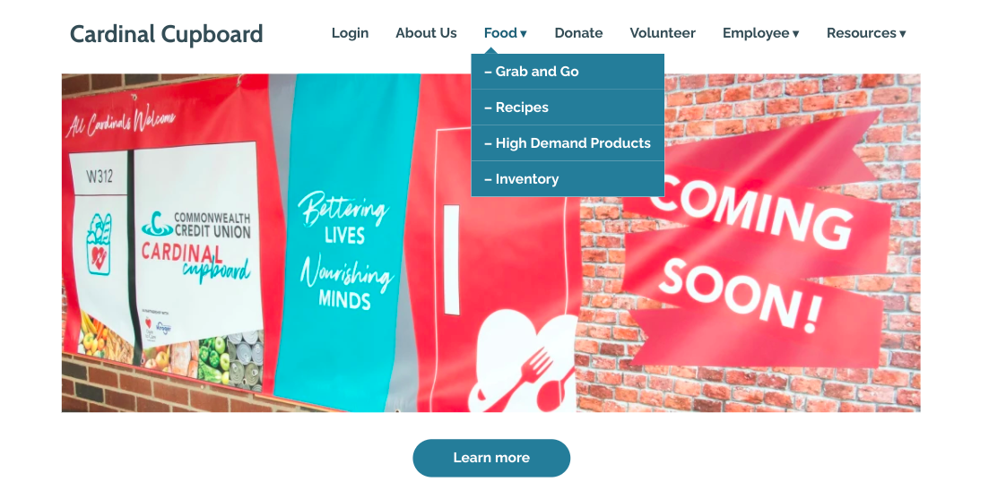
Homepage - Food

Slide 18
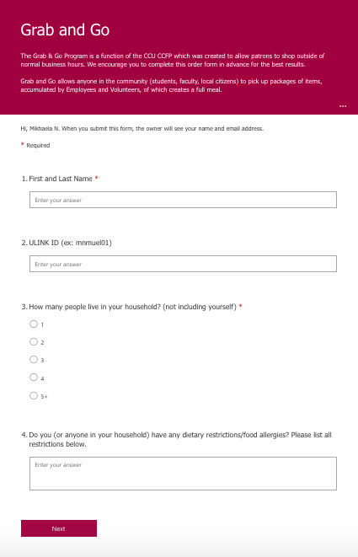
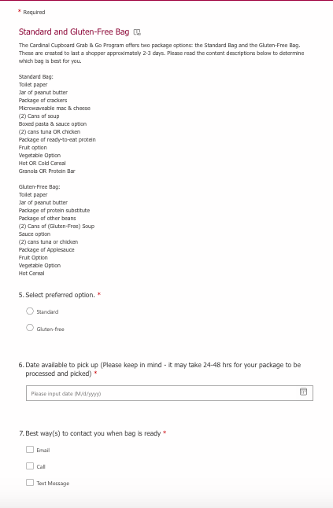
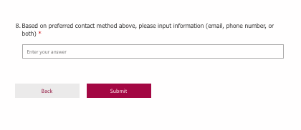
Food – Grab & Go

Slide 19
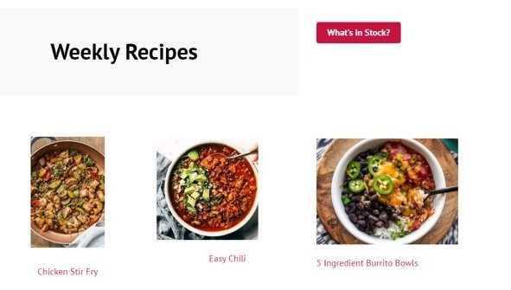
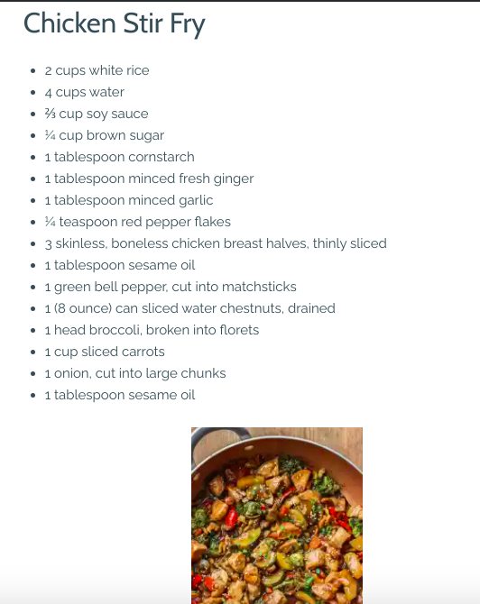
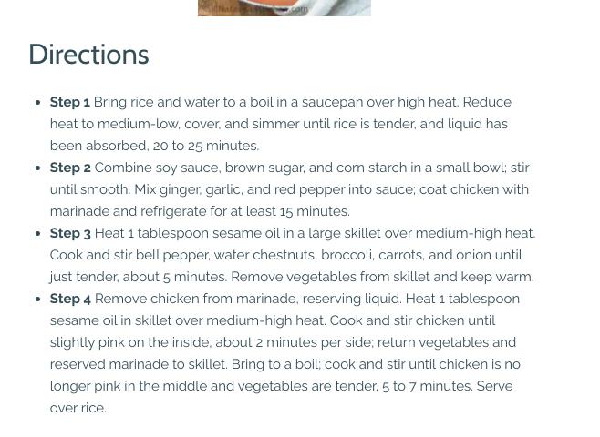
Food - Recipes
Food - Recipes

Slide 20
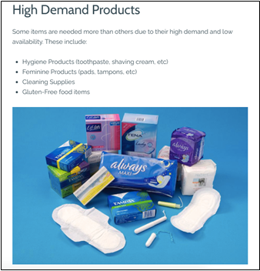
Food – High Demand Products

Slide 21
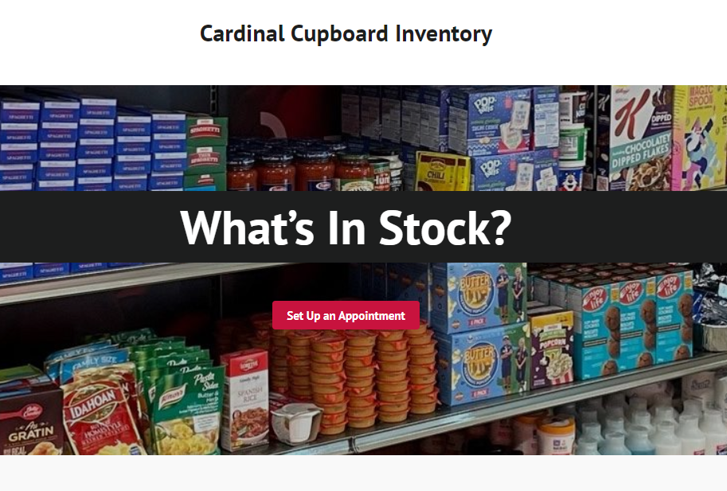
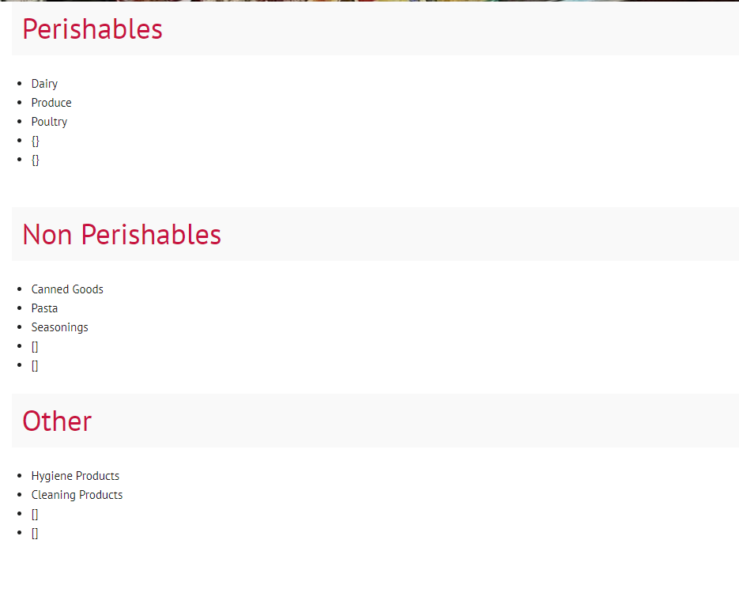
Food - Inventory

Slide 22
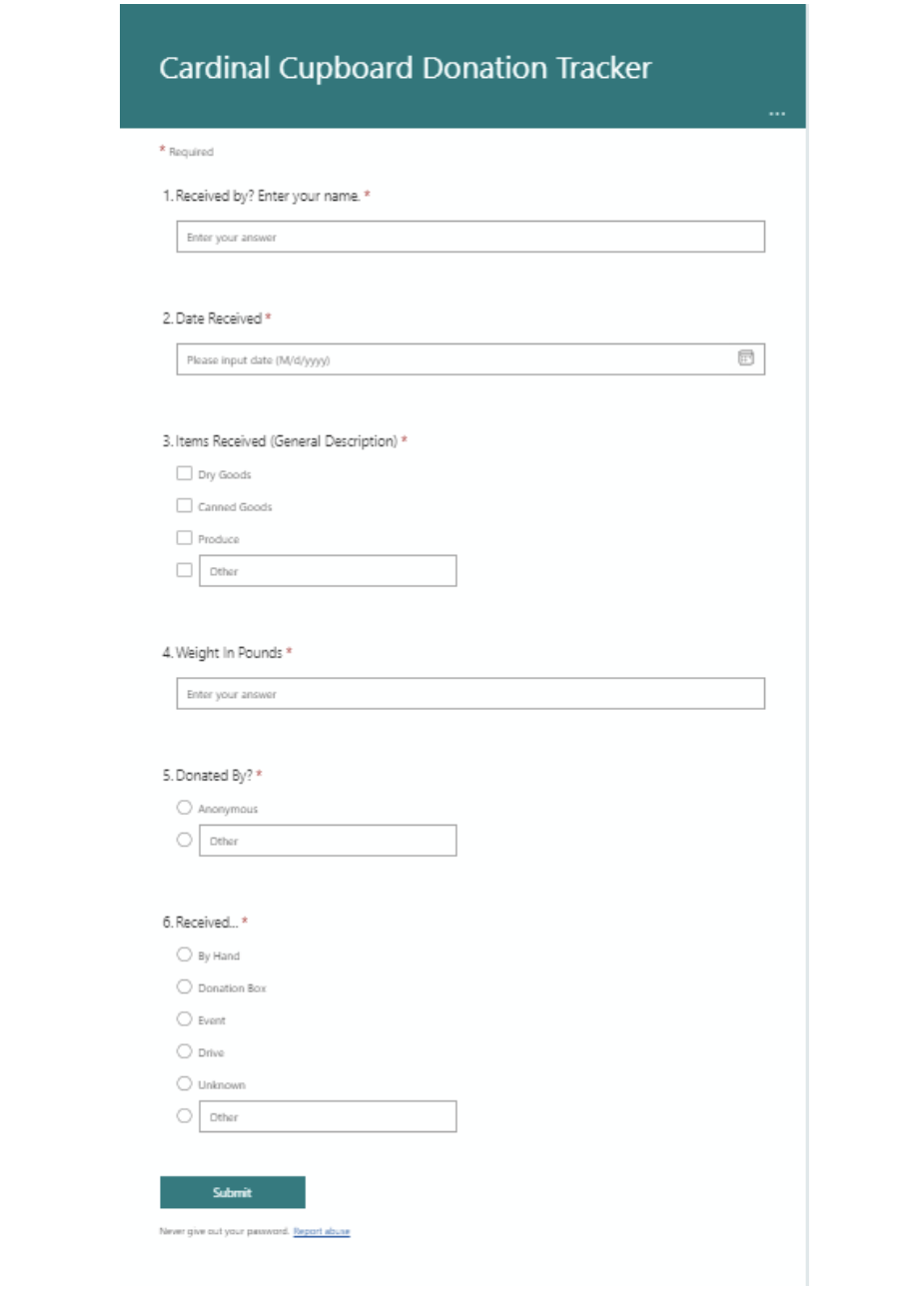
Food – Donation Tracker Form

Slide 23
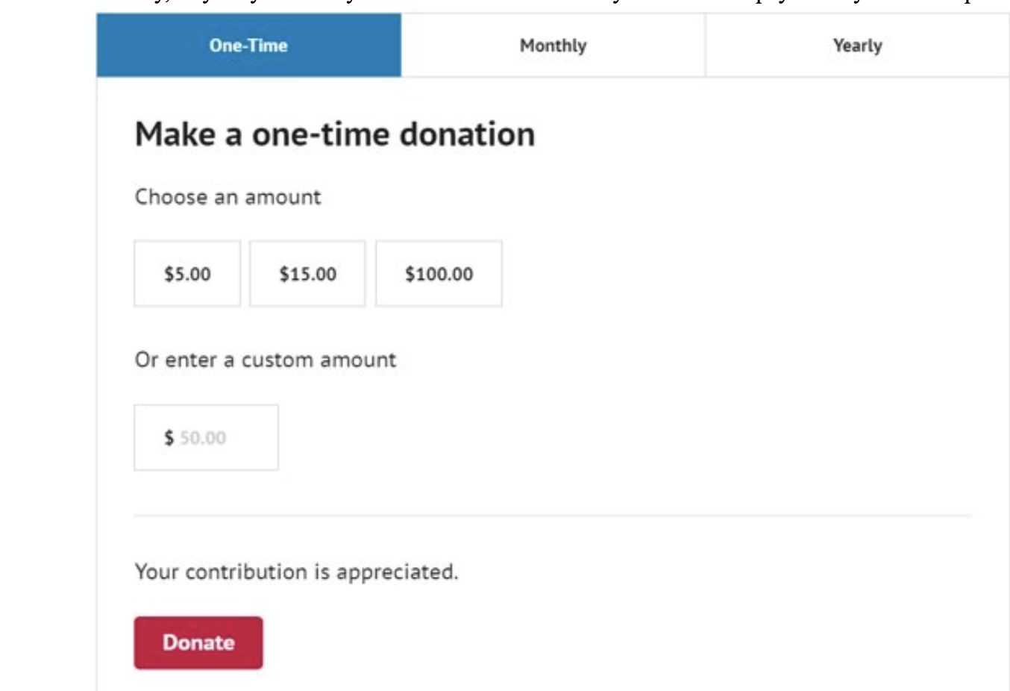
Donate

Slide 24
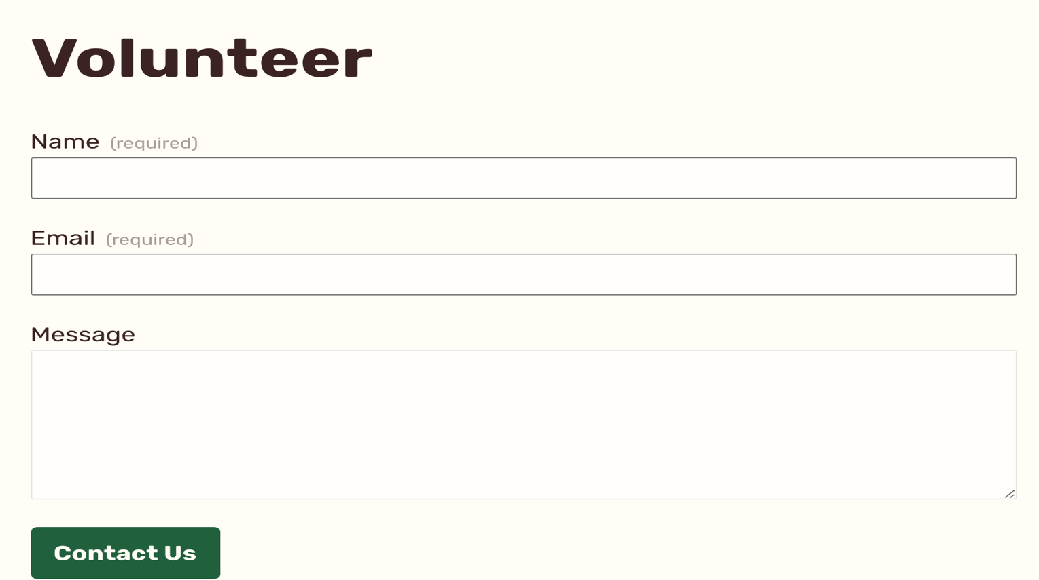
Volunteer – Sign Up

Slide 25
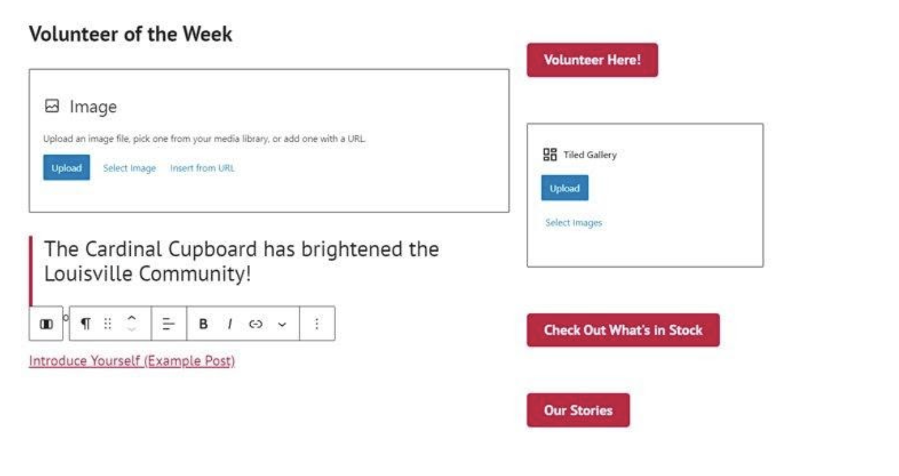
Volunteer

Slide 26
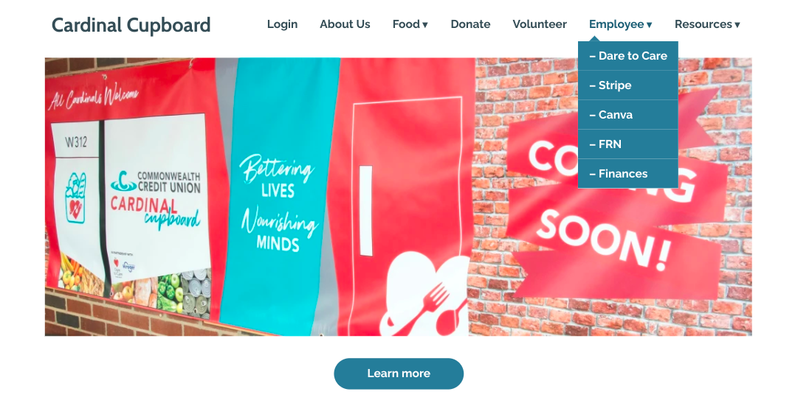
Homepage - Employee

Slide 27

Employee Access – Dare to Care

Slide 28
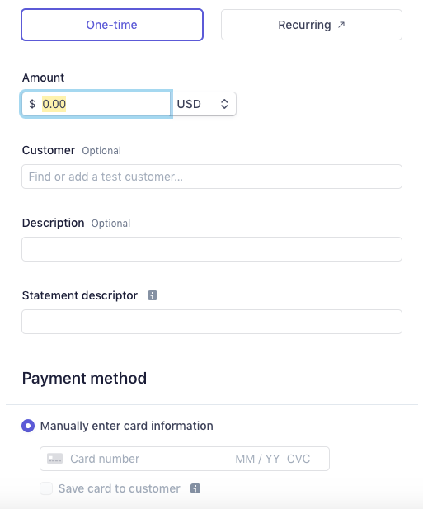
Employee Access - Stripe

Slide 29

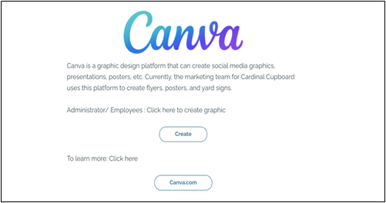
Employee Access - Canva

Slide 30
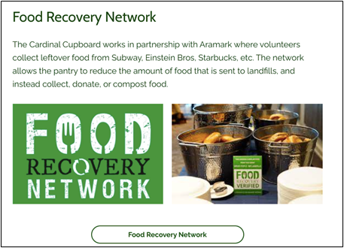
Employee Access - FRN

Slide 31
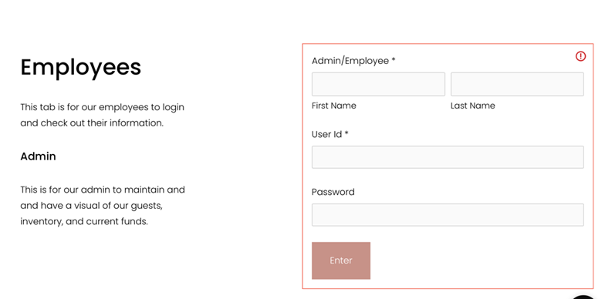
Employee Access - Finances

Slide 32
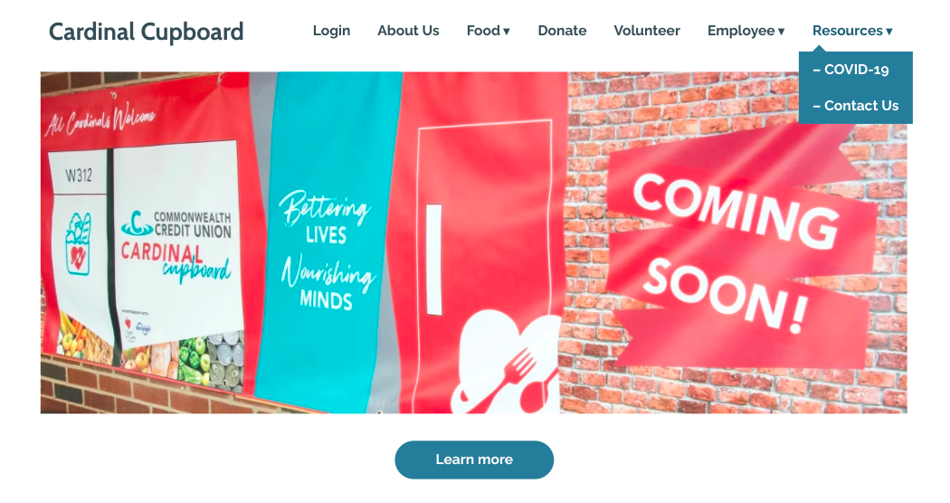
Homepage - Resources

Slide 33
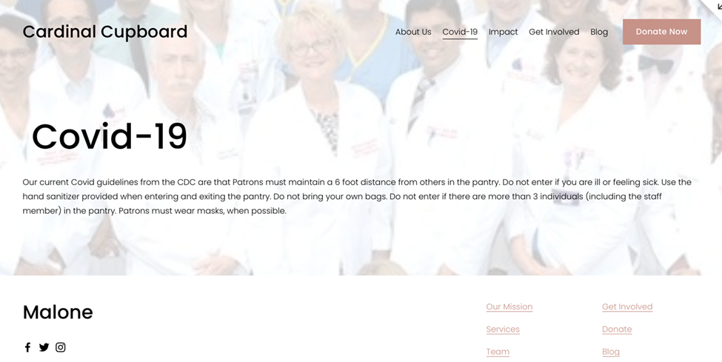
Resources – Covid-19

Slide 34
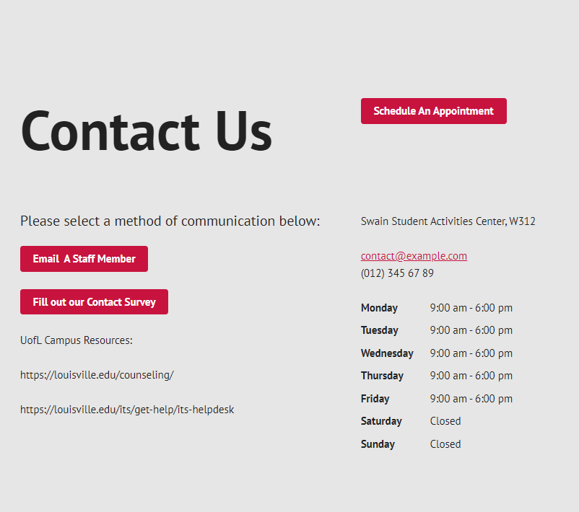
Resources – Contact Us

Slide 35
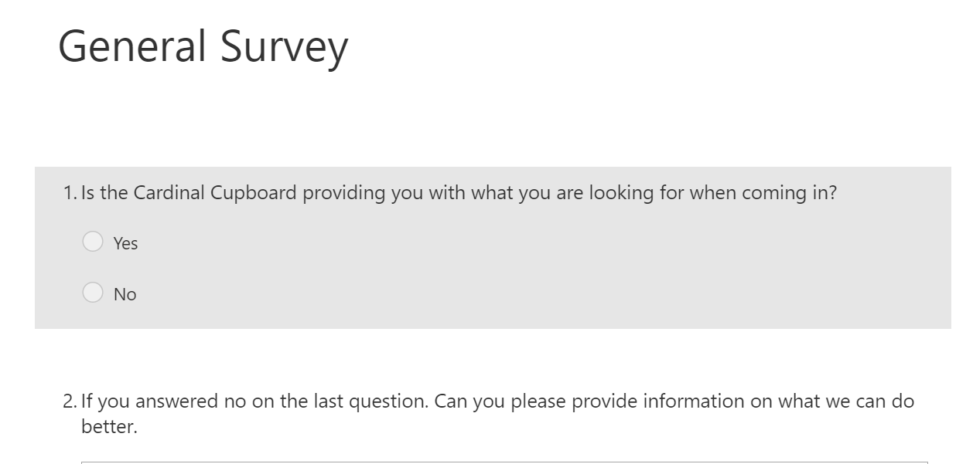
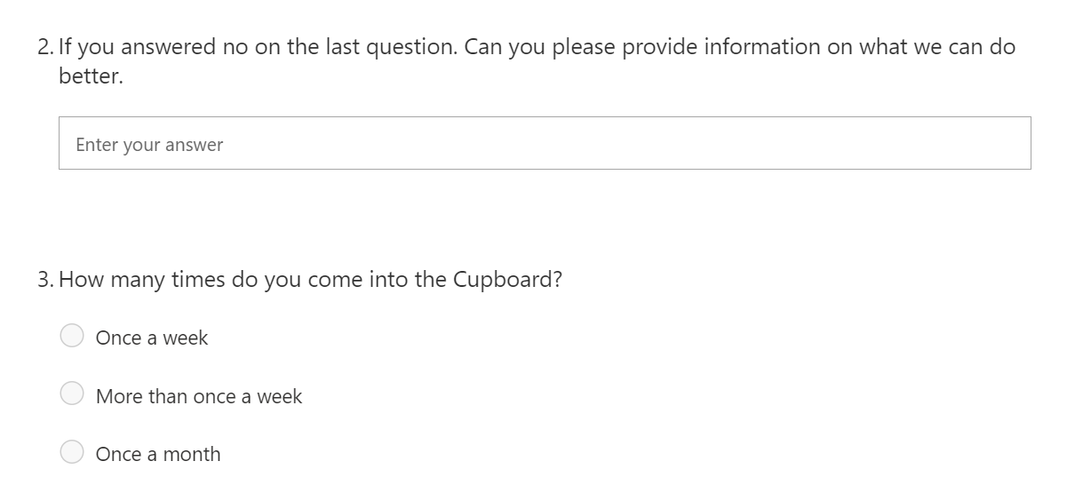
Contact Us – General Survey

Slide 36
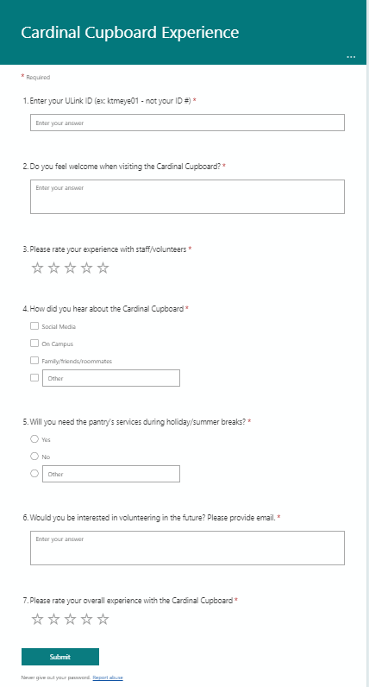
Contact Us – Experience Form

Slide 37
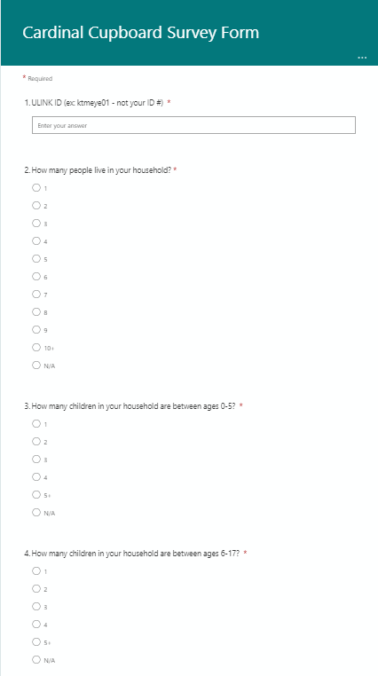
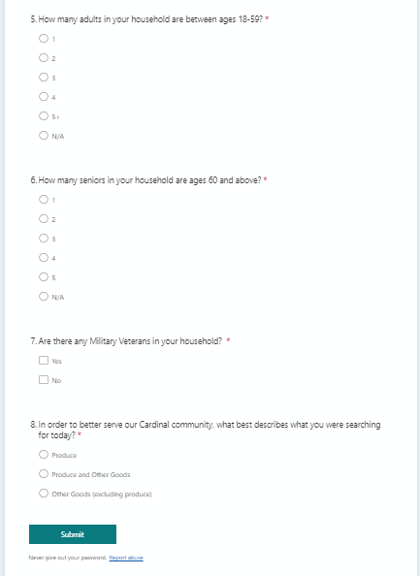
Contact Us – Intake Form Survey

Slide 38
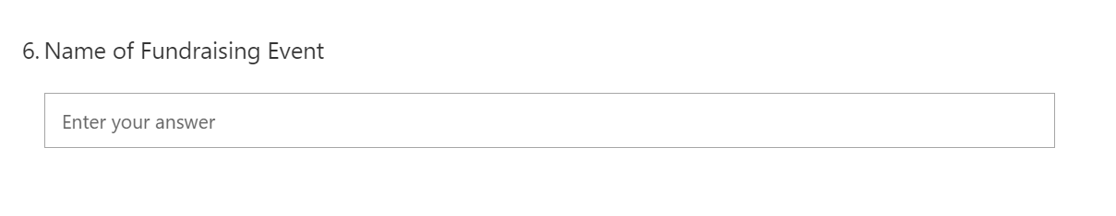
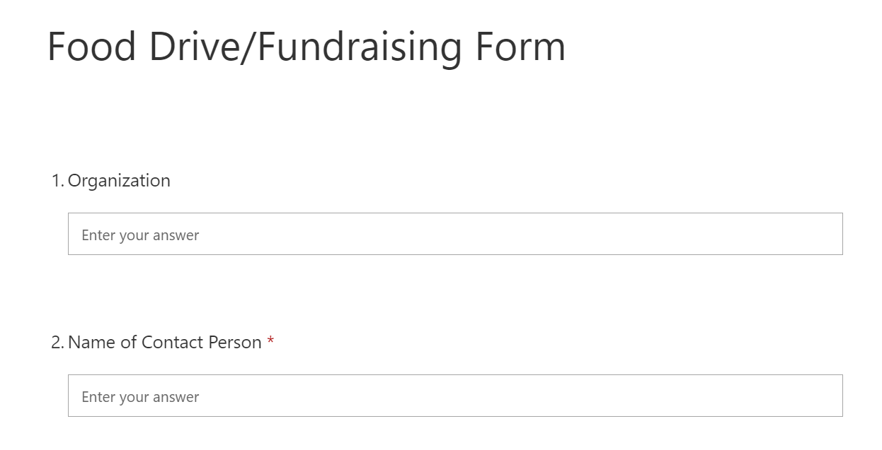
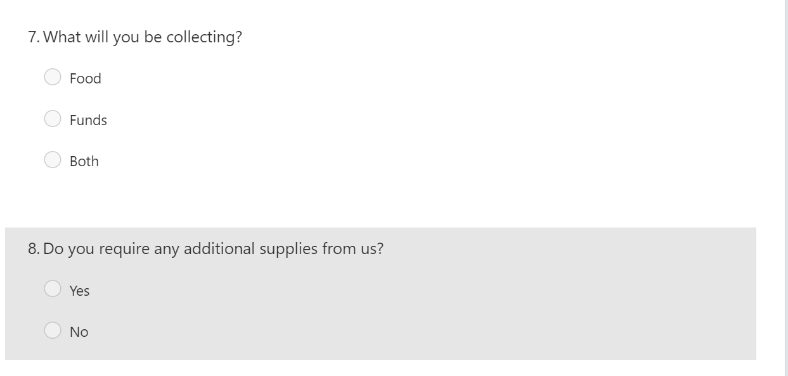
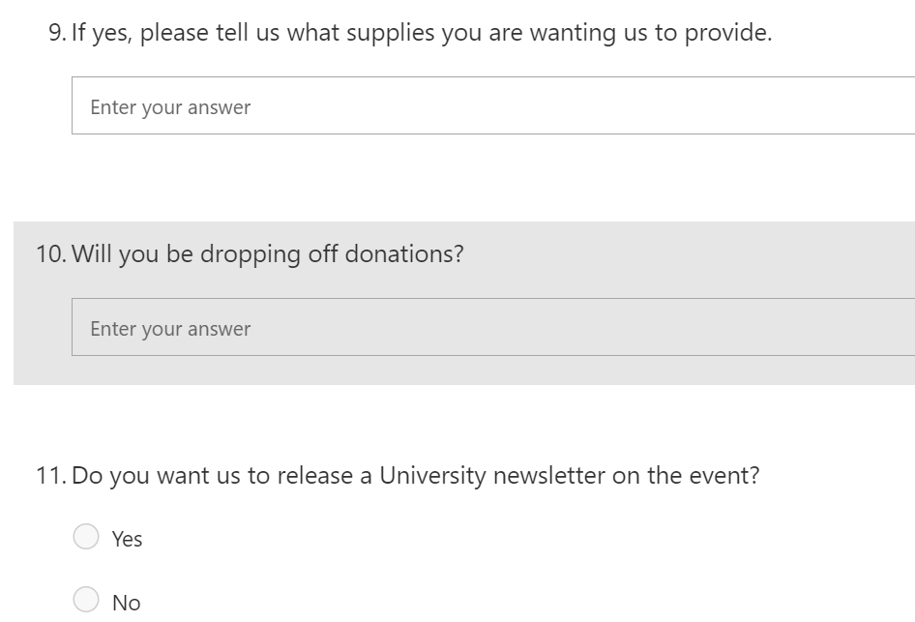
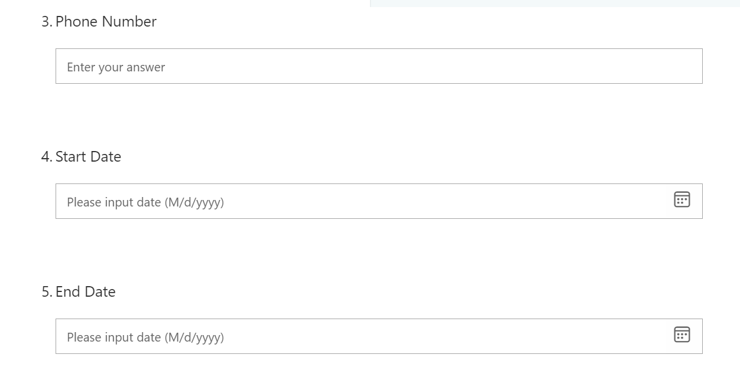
Contact Us – Food Drive Form

Slide 39
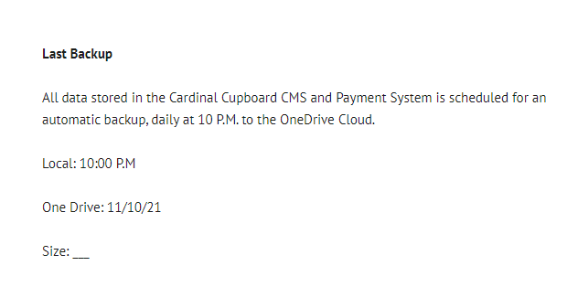
Backup of System

Slide 40
Conclusion/Questions?
By using the tools outlined in the presentation, the website for the Cardinal Cupboard will be easier to develop
The navigation and layout will provide an easy system for employees and customers to use
The goal is to have a user-friendly system that allows Cardinal Cupboard to collect and retain data and encourage new donors
Questions?

